Slide 1
Big Mountain Resort
Siddharth Shah

Slide 2
OUTLINE
Problem Identification
Key Findings
Recommendation
Modeling Results
Analysis
Summary

Slide 3

Problem Identification
Recently installed Lift for better customer distribution
Operating cost increased by $ 1.5 M
Find Which features are more important compare to others
Increase revenue
Better ticket pricing based on facilities
Cut down operation cost
Data Source: .csv file with 330 resorts data across USA.

Slide 4
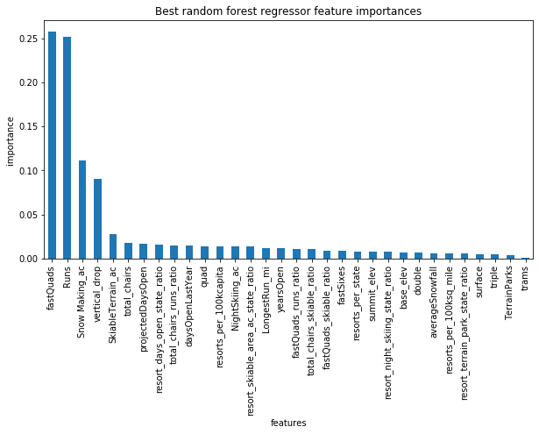
Key findings
Data missing for some fields
No clear relation between State, Population to Ticket Price
Target Feature: Adult Weekend Price
Key Features:
FastQuad
Runs
Snowmaking_ac
Vertical Drop

Slide 5

Recommendation
Immediately Increase ticket price up to $94
Permanently close one least used run. (No change)
Decrease the Skiable Terrain by 248 acres (No change)
Add one more FastQuad (+$23)
Increase vertical drop by 363 feet (+$6)
Increase snowmaking area by 54 acres (+$4.5)
Increase run and total chairs by one and vertical drop by 150 feet (+$2)

Slide 6
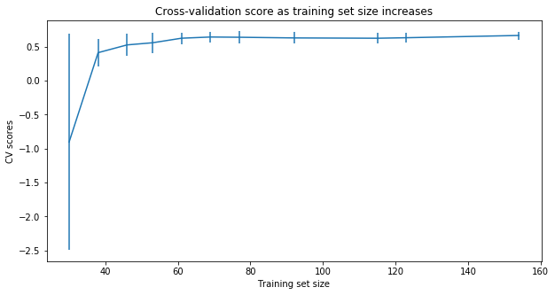
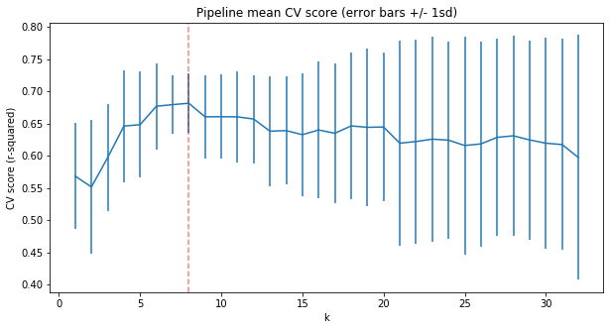
Modeling result
Random Forest Algorithm : Lower cross validation result
DATA Assessment
Enough data for modeling.
Number of features to be consider

Slide 7
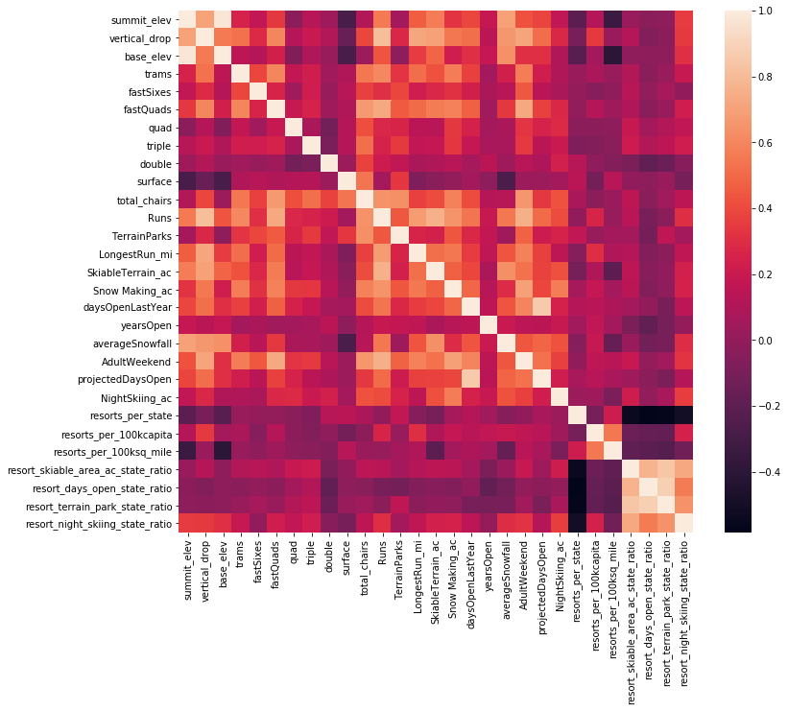
analysis
Heatmap

Slide 8
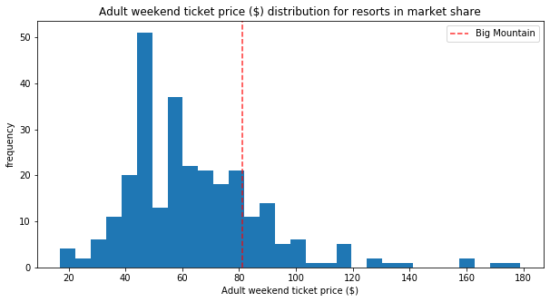
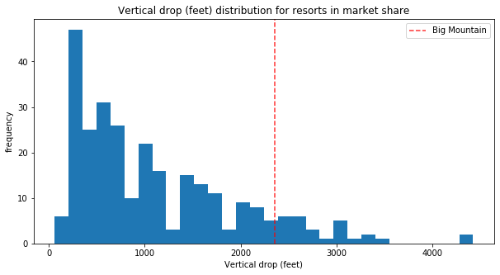
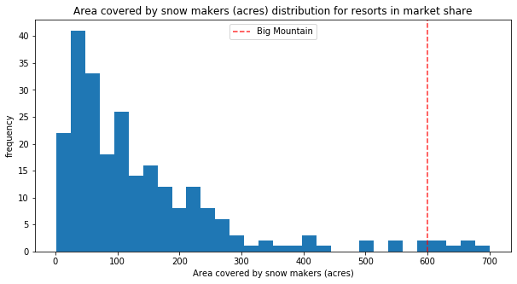
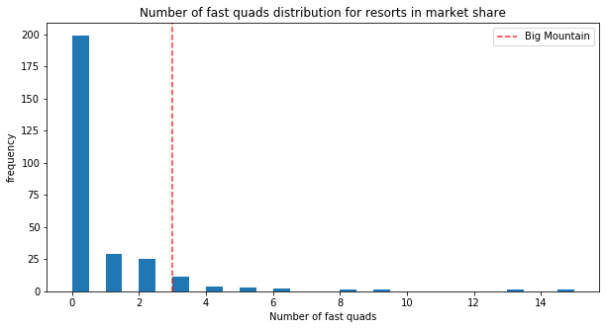
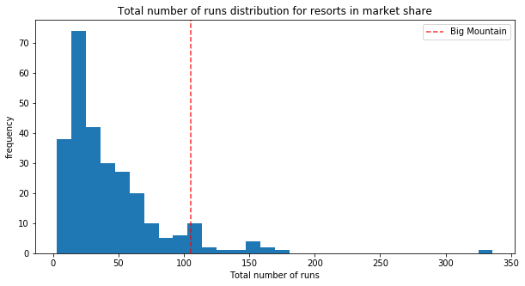
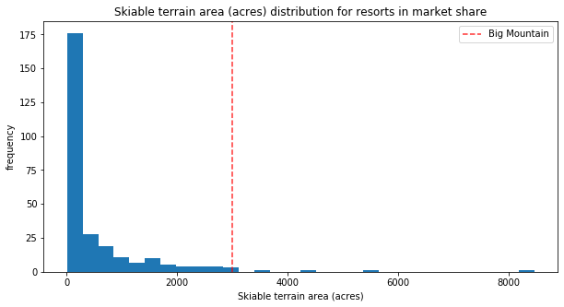
analysis
Big Mountain Resort position among other resort in key features

Slide 9
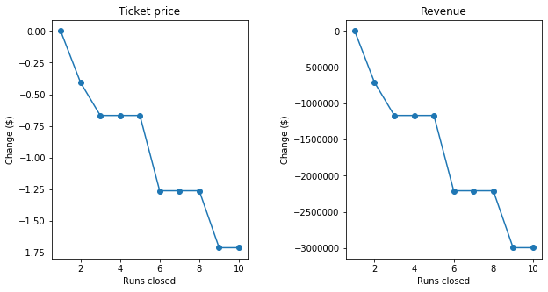
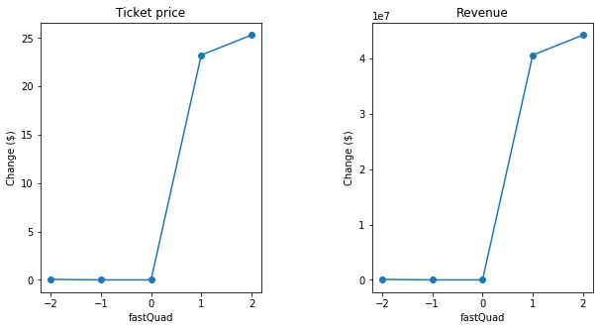
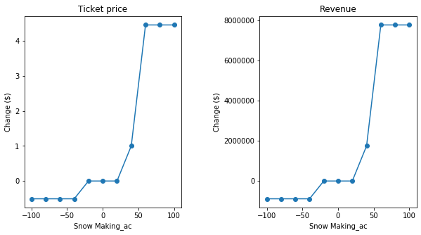
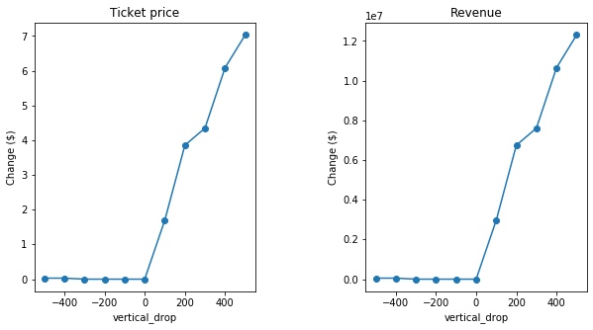
analysis
Ticket predicted price change based on Key features modification

Slide 10
Summary
Data missing and not accurate for some fields
Key features affecting Ticket price are:
FastQuad
Runs
Snowmaking_ac
Vertical Drop
Increase Revenue:
Increase Ticket Price
Increase adult ticket price up to $94 based on the model
Add one more FastQuad (+$23)
Increase vertical drop by 363 feet (+$6)
Increase snowmaking area by 54 acres (+$4.5)
Decrease Operating Cost
Permanently close one least used run
Decrease the Skiable Terrain up to 248 acres

